Slide 1


Specification of the Database
Application
​
The defense slides by Mou Yangchen
​

Slide 2

01
The basic client
The instruction for clien without GUI
CONTENTS
02
The advaned client
The instruction for client with GUI
Introduction to the system
03
The server system
The introduction about the server system

Slide 3




List
​
Exist
​
Compare
​
Upload
​
Download
​
Delete
01
The basic client
The instruction for client without GUI
Operations offered

Slide 4

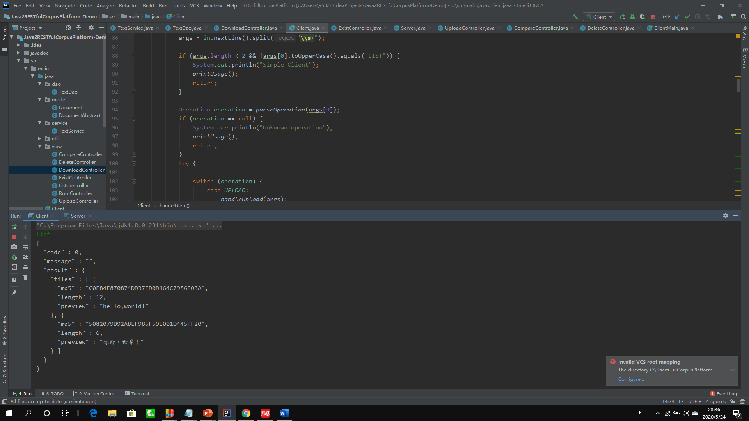
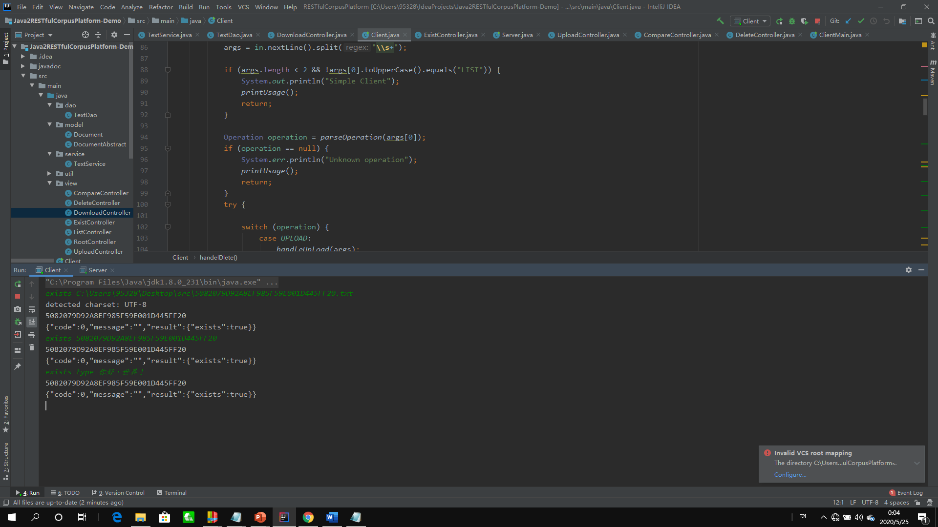
LIST
Show the files in the database now
Exist
Check whether the file exists in the database
The user should type the word “exists” first (regardless of case) to inform the class of operation. Then he could type the file path (the detected charset will be return), the md5 code of the file or type the key word “type” and enter the context of the file.
The client will print out the result to claim whether the file exists.
The user can directly type the word “list” (regardless of case) into the terminal the client will print out all the files in the database with the md5, file length and the preview of the file context.

Slide 5
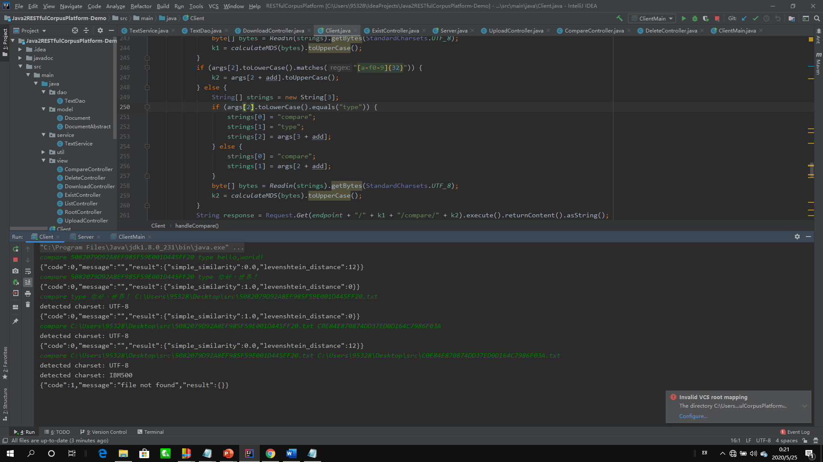
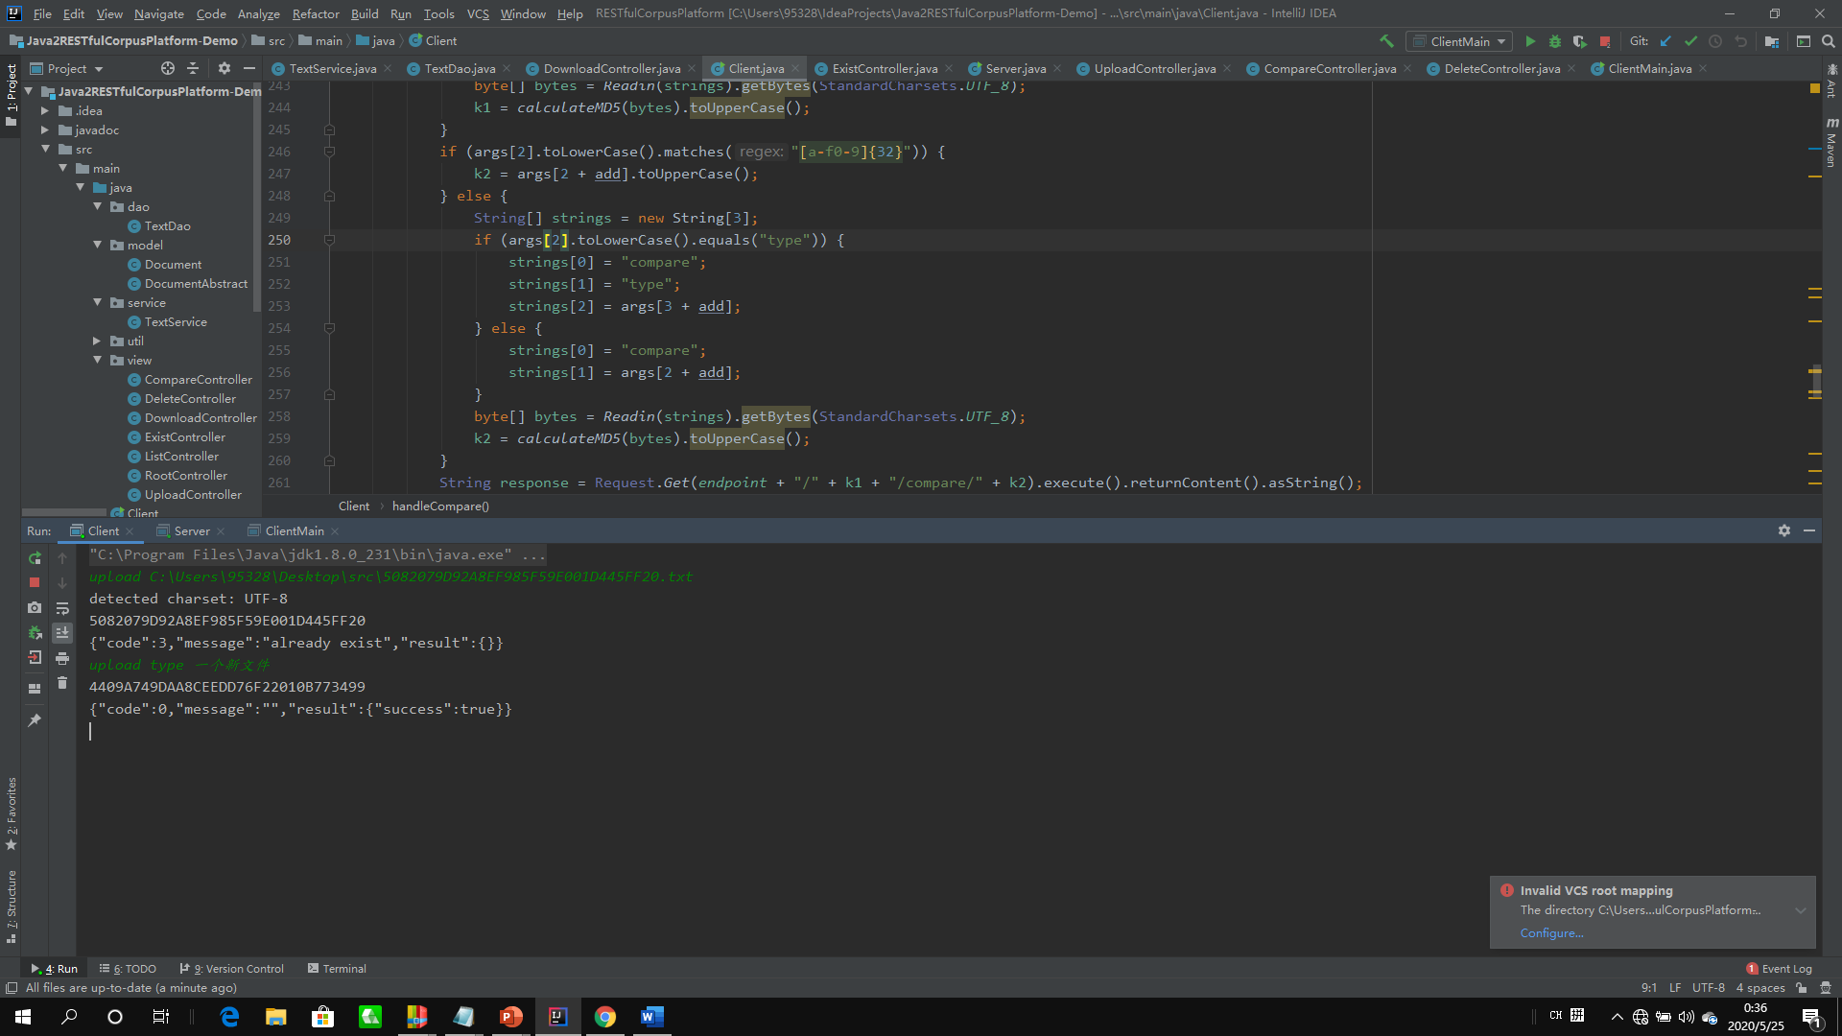
Compare
Calculate the distance of two files
Upload
Upload a local file to the database
The user should type the word “compare” first (regardless of case) to inform the class of operation. The user can also choose to enter the file path, md5 code or the context to the client, and it will return the calculated simple distance and the levenshtein distance of two files.
It may also return error message of “file not found” if there is no such files in the database
The user should type the word “upload” first (regardless of case) to inform the class of operation. Then he could type the file path (the detected charset will be return or type the key word “type” and enter the context of the file.
It may also return error message of “file already exist” if there has already been such file in the database. If the client goes wrong when calculate the md5, the server will return the “Hash not match “ error message.

Slide 6
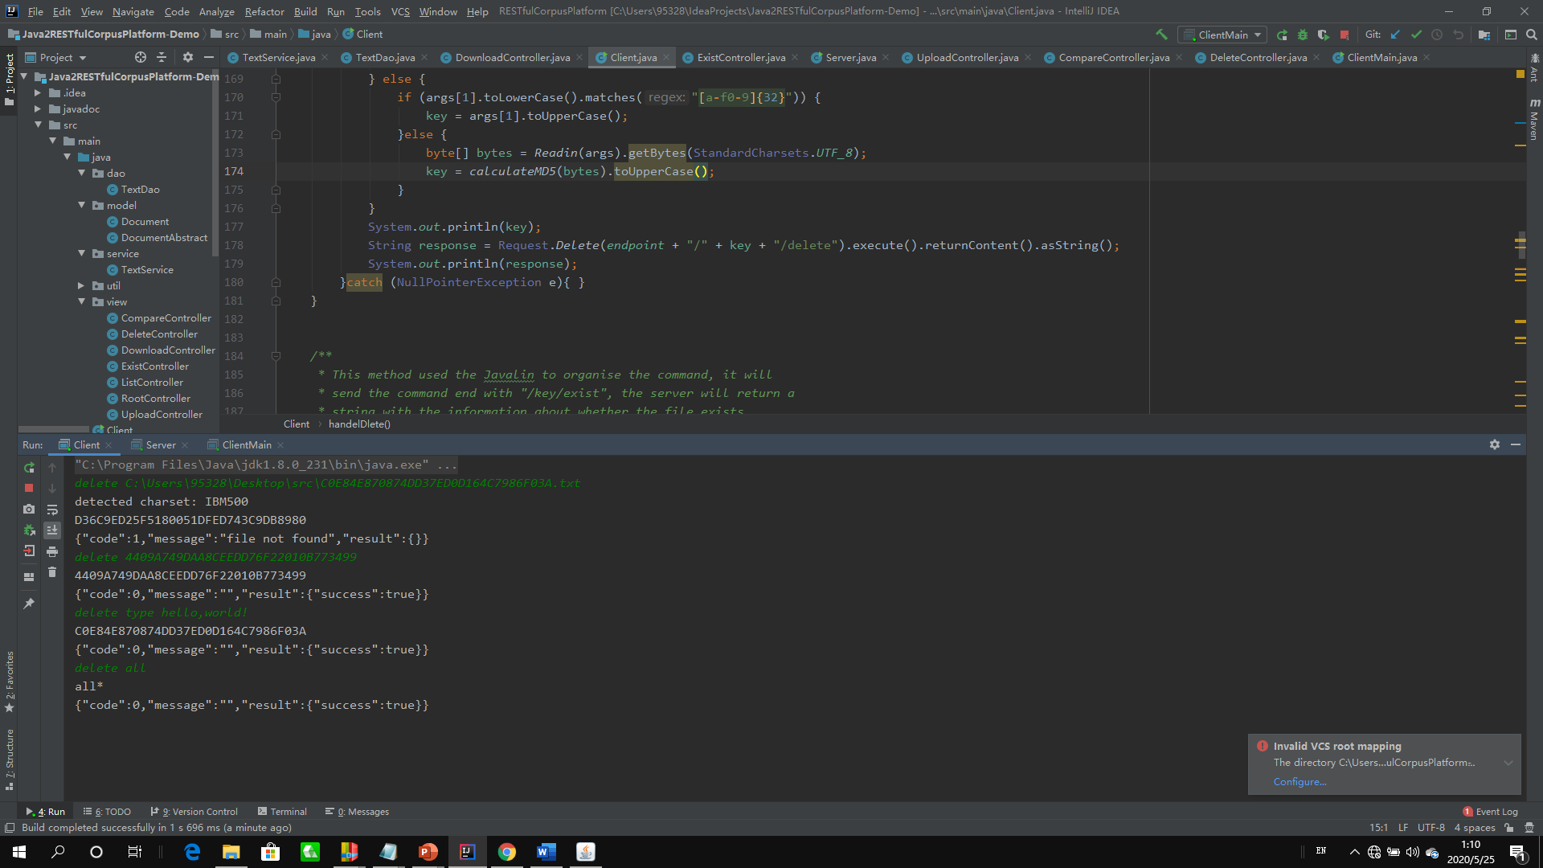
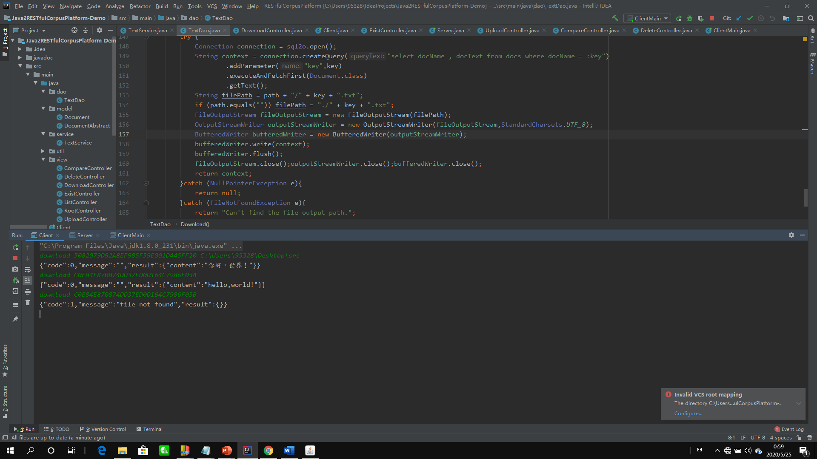
Download
Download the file to local memory
Delete
Delete the file from the database
The user should type the word “download” first (regardless of case) to inform the class of operation. The user should than type the md5 code of the file and the output path. If no path parameter entered, the file will be put in the root path of the project.
It may also return error message of “file not found” if there is no such files in the database
The user should type the word “delete” first (regardless of case) to inform the class of operation. Then he could enter the file path (the detected charset will be return),md5 code or type the key word “type” and enter the context of the file. He could enter “all” to clear the database.
It may also return error message of “file not found” if there is no such files in the database

Slide 7
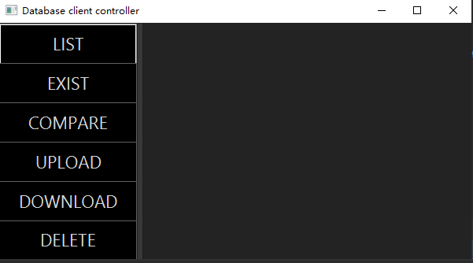
02
The advanced client
The instruction for client with GUI
The Main Menu
The user could click the button on the left-side main menu to choose the function he wants.
You can also can change the style of the client in the css file.

Slide 8
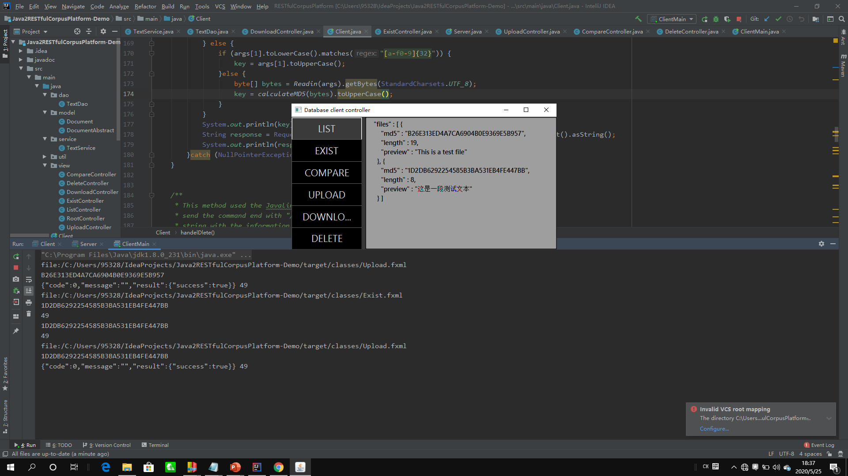
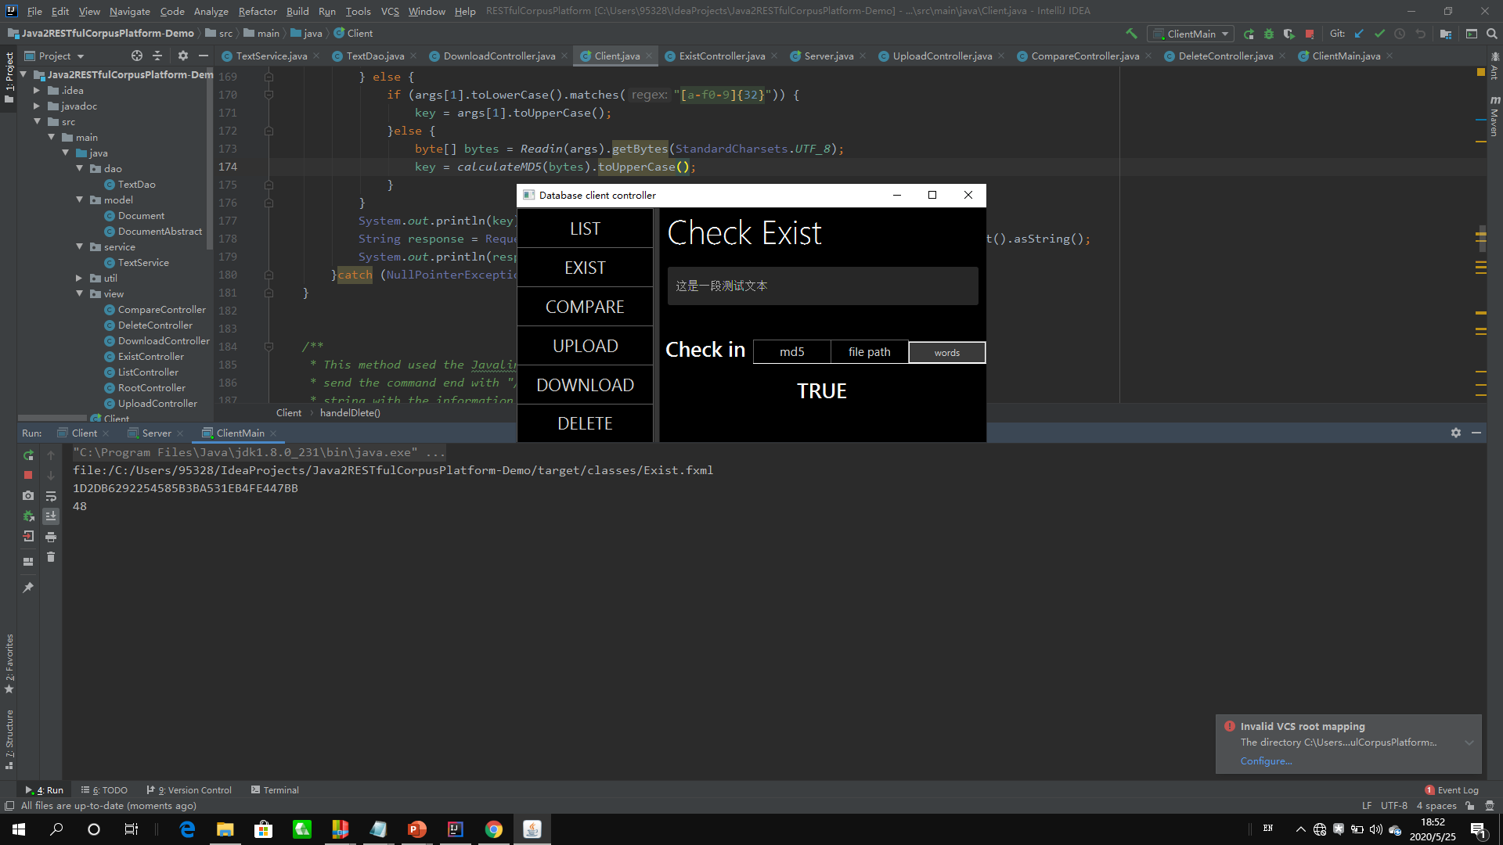
LIST
Show the files in the database now
Exist
Check whether the file exists in the database
The user could either enter the md5 code or the context of the file directly into the text-field. If the user click the file path button , a file-chooser will be open for the checked file.
The client will show the warning dialog if the md5 code doesn’t match with the md5 form or the file-chooser was unexpectedly shut down.
The user presses the button “list”, client will print out all the files in the database with the md5, file length and the preview of the file context at the left side of the interface.

Slide 9
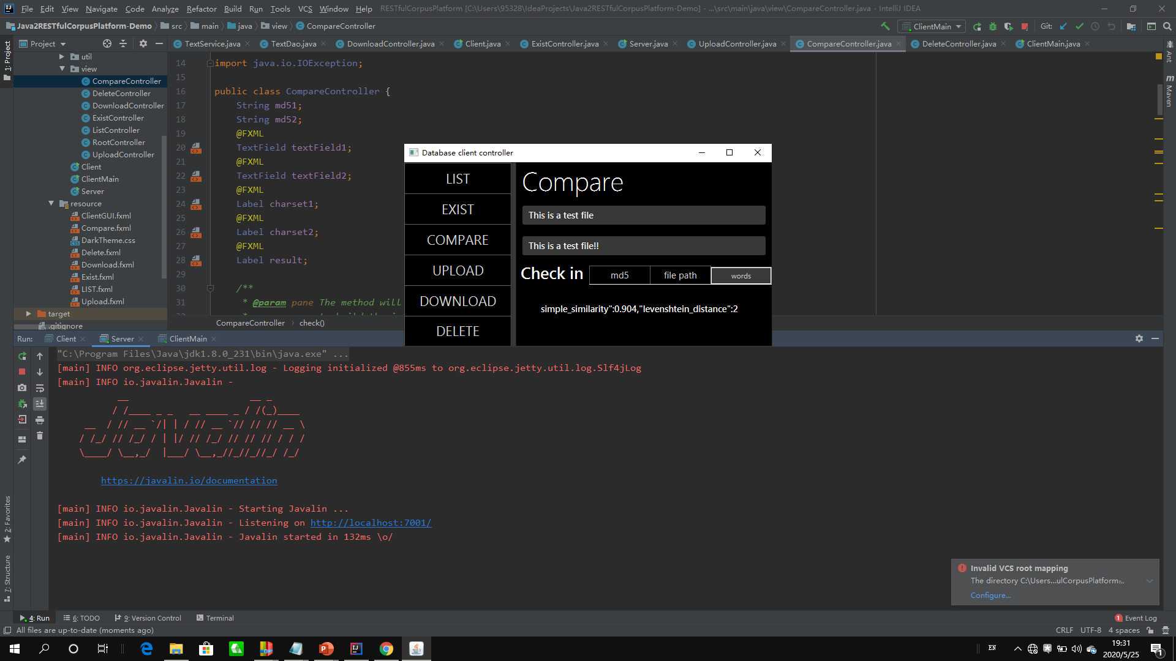
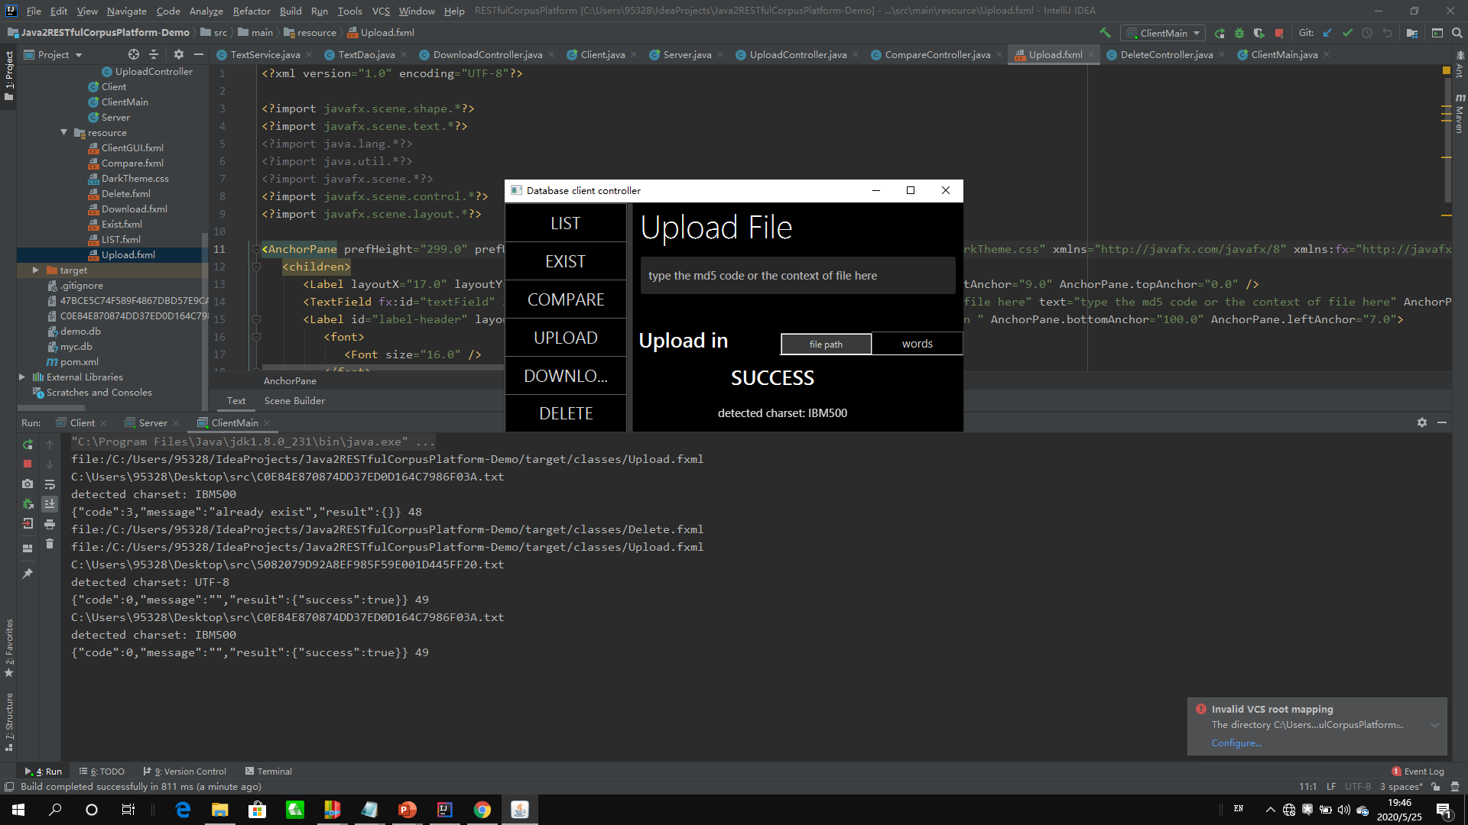
Compare
Calculate the distance of two files
Upload
Upload a local file to the database
The user could either enter the md5 code or the context of the file directly into the text-field. If the user click the file path button , a file-chooser will be open for the checked file, and the detected charset will be shown.
The client will show the warning dialog if the md5 code doesn’t match with the md5 form or the file-chooser was unexpectedly shut down. It may also the result of “No such file in the database”.
The user could either enter the md5 code or the context of the file directly into the text-field. If the user click the file path button , a file-chooser will be open for the checked file, and the detected charset will be shown.
The client will show the warning dialog if the md5 code doesn’t match with the md5 form or the file-chooser was unexpectedly shut down. It may also return error message of “file already exist” if there has already been such file in the database

Slide 10
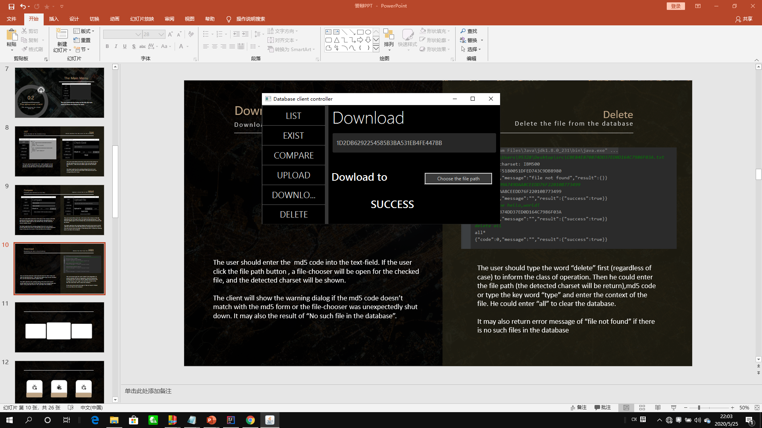
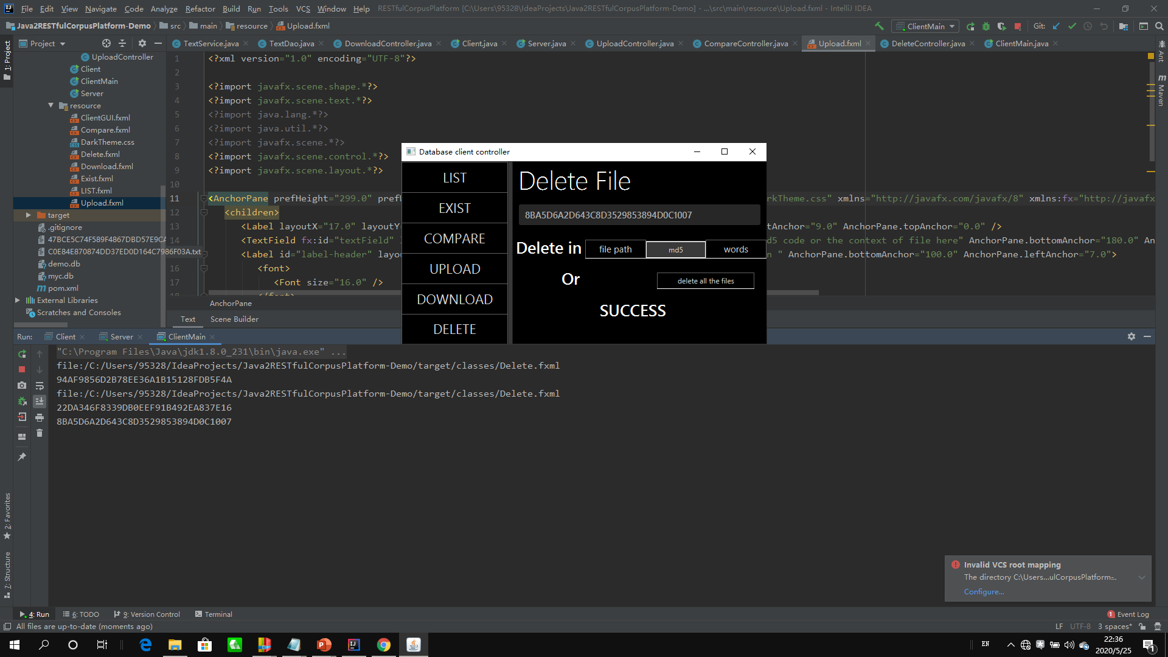
Download
Download the file to local memory
Delete
Delete the file from the database
The user should enter the md5 code into the text-field. If the user click the file path button , a file-chooser will be open for the checked file, and the detected charset will be shown.
The client will show the warning dialog if the md5 code doesn’t match with the md5 form or the file-chooser was unexpectedly shut down. It may also the result of “No such file in the database”.
The user could either enter the md5 code or the context of the file directly into the text-field. If the user click the file path button , a file-chooser will be open for the checked file, and the detected charset will be shown. The user could also click the “delete all the files”
The client will show the warning dialog if the md5 code doesn’t match with the md5 form or the file-chooser was unexpectedly shut down. It may also the result of “No such file in the database”.

Slide 11



03
The Server System
A brief introduction to the Server
The Server
The Controller
Server.class
The Analyzer
TextService.class
The Storage
TextDao.class

Slide 12





The Server System
Controller
Analyzer
Storage
Once the main function of Server Class (the central controller which also work as the server of Javalin) receive the command from the client, it will invoke the corresponding method in the TextService class.
The TextService is the analyzer of the system, it handles the command types and do preparatory or follow-up works like executing primary exams or read in the file according to the files.
The storage program (TextDao class) will be called by the analyzer to connect with the database. This program will simply do select, insert or delete jobs with sqlo2 and return the result.

Slide 13
THANK YOU
11811907 牟洋忱

